Slide 1




AWS Cloud Final Project
Design of a highly available, scalable, and resilient AWS cloud architecture to host web application .
Digital Egypt Pioneers initiative
Provided by NTI

Slide 2
Team Members
Reham Maher Abdelfattah
Reem Wael yossef
Ziad Hossam salah
Ahmed Mohamed Emam
Group code
DEPI_1_CAI1_ISS4_S1e
AWS Cloud Solution Admin & Architec

Slide 3
Project Objectives
Create Network Environment: Built with Infrastructure as Code (IaC) for automated provisioning.
Host Web App: Deployed on EC2 instances or microservices architecture.
External Storage: Static content stored on AWS S3, not on the EC2 EBS volumes.
Monitoring & Alerts: Servers are monitored using AWS CloudWatch, with email notifications triggered when metrics exceed limits.
Automatic Remediation: If web services fail, an automatic response (e.g., restarting services) is
triggered.
Environment Requirements: Secure, highly available, scalable, and disaster recovery-enabled
infrastructure.

Slide 4
Project Overview
Objective: To build a secure, highly available, scalable infrastructure for a web application
using AWS.
Scope:
Automated infrastructure deployment with Infrastructure as Code.
Hosting web applications on EC2 with auto-scaling and load balancing.
Integration of monitoring and automated remediation.
External storage for static content and disaster recovery plan

Slide 5
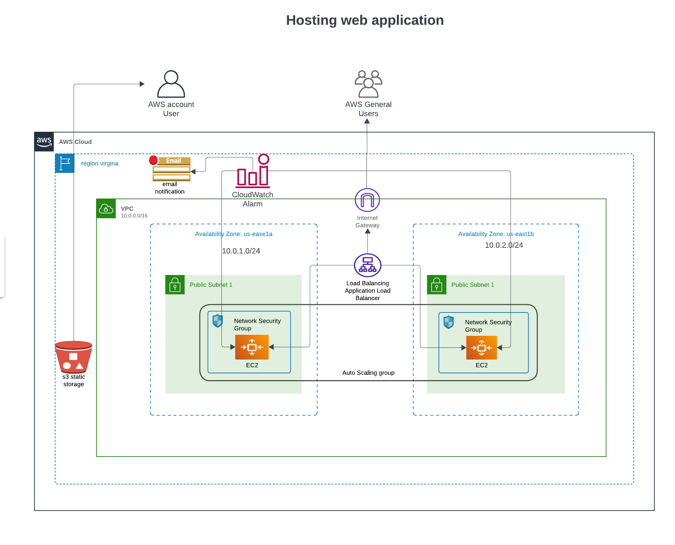
Infrastructue Archeticture

Slide 6
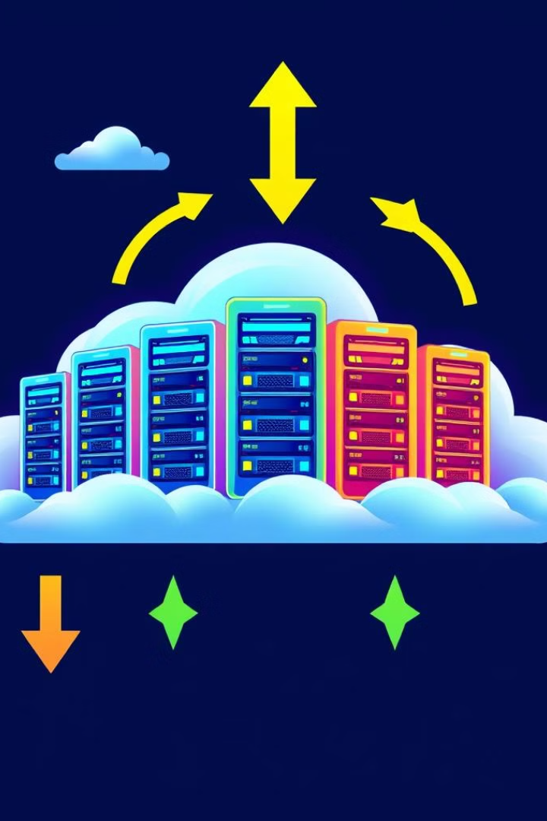
key Components
VPC: Virtual Private Cloud for network isolation.
Availability Zones: Two AZs (us-east-1a, us-east-1b) for redundancy.
EC2 Instances: Deployed in auto-scaling groups behind
an Application Load Balancer.
S3 Bucket: For storing static content externally.
CloudWatch Alarms: Monitors the system with email alerts.
Load Balancer: Distributes traffic across EC2 instances.
Auto Scaling Group : Automatically adjusts the number
of EC2 instances

Slide 7
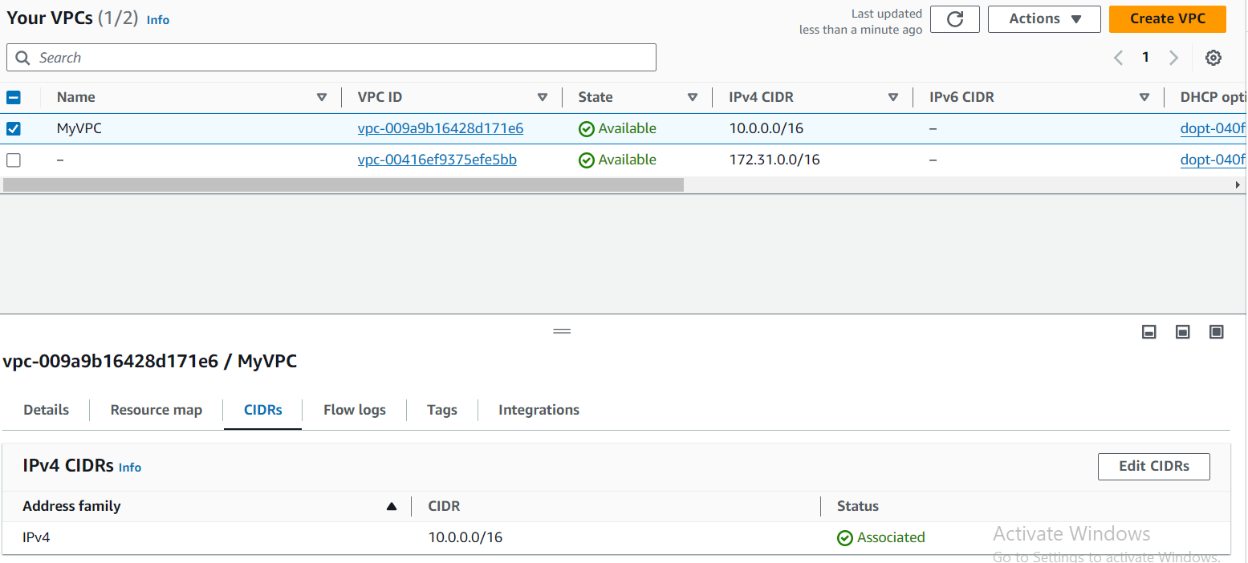
Project Steps
Step 1 : Set up VPC and Subnets using CloudFormation Explanation:
The network environment was created using AWS CloudFormation, which allowed for Infrastructure as Code (IaC). A YAML file was added to define and provision the VPC, subnets, Internet Gateway, and route tables.
The YAML file automates the creation of:
A VPC with a CIDR block of 10.0.0.0/16.
Two public subnets (one in each availability zone, us-east-1a and us-east-1b) to ensure high availability.
An Internet Gateway attached to the VPC for internet connectivity

Slide 8
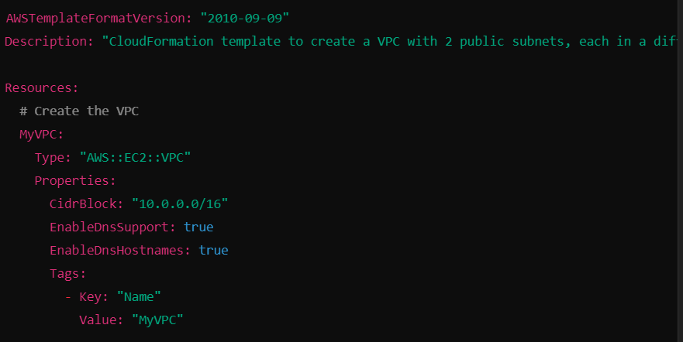
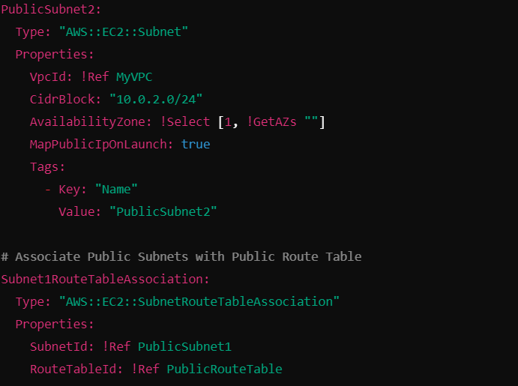
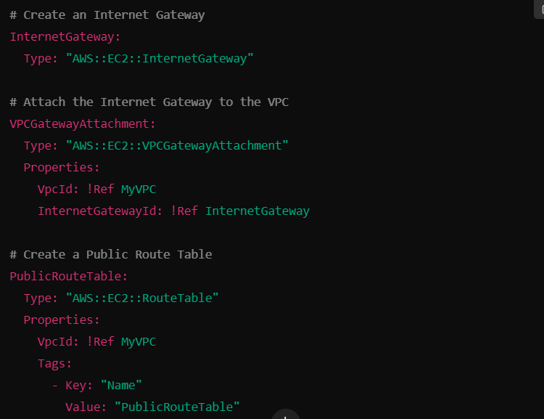
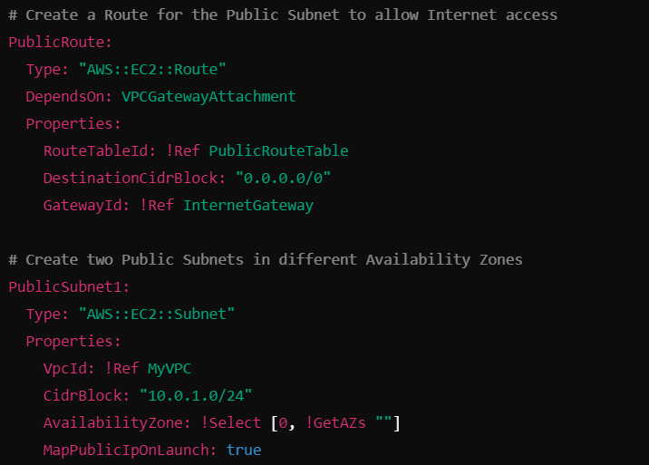
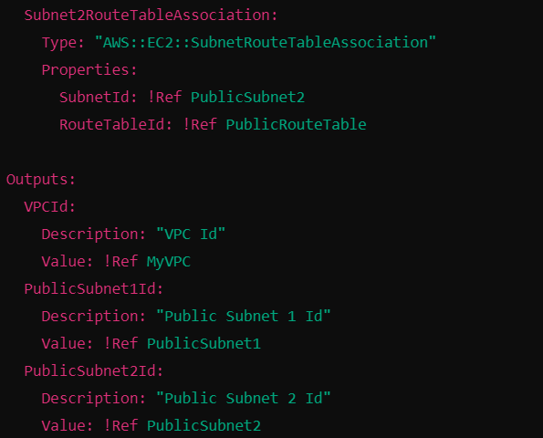
Project Steps
Vpc.yaml file

Slide 9
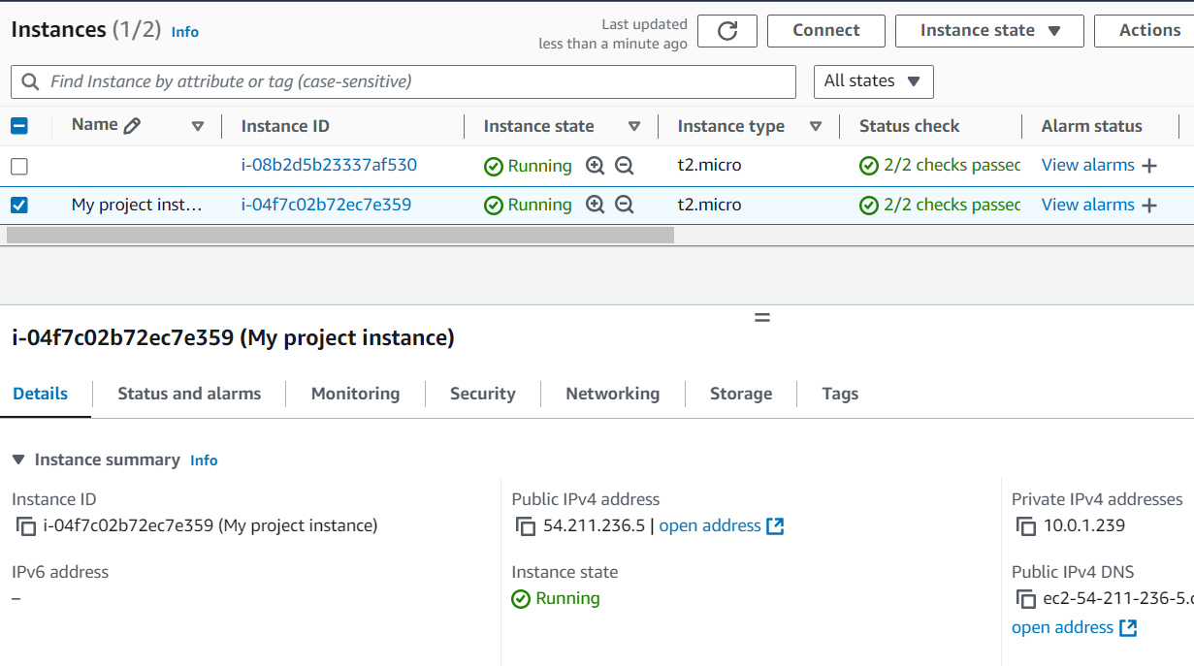
Project Steps
Step 2: Deploy EC2 Instance and Secure it with Security Group
Launched EC2 instance within the public subnet1
A Security Group were created and attached to the EC2 instances to control inbound and outbound traffic. Only SSH (port 22) and HTTP (ports 80) traffic were allowed for secure communication.
After launching the instances, they were accessed using SSH from your terminal and installing apache on it and upload my index.html code

Slide 10
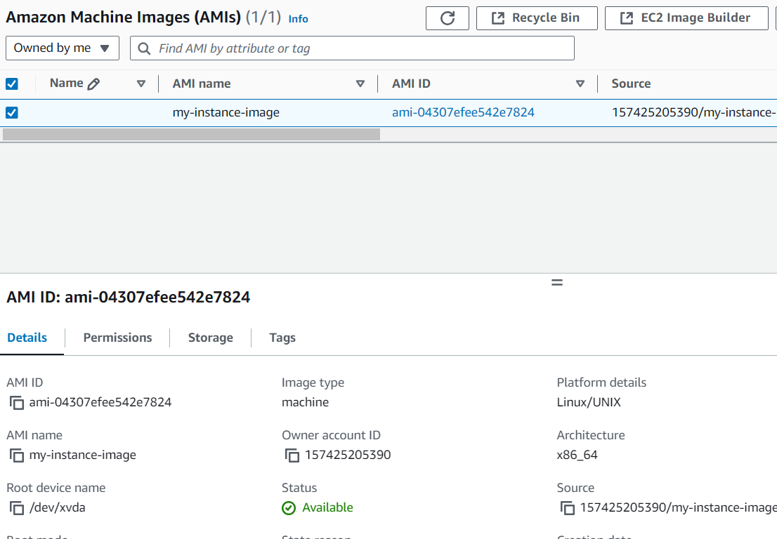
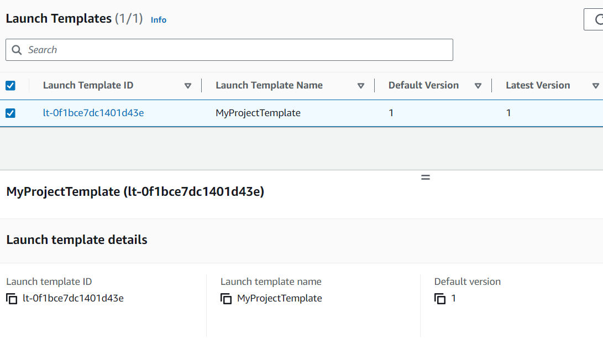
Project Steps
Step 3 : Create AMI from EC2 Instance and Launch Template
After configuring and setting up the EC2 instance, an Amazon Machine Image (AMI) was created from this instance. The AMI captures the configuration, software, and settings of the instance
The AMI was then used to create a Launch Template, which simplifies the process of launching new EC2 instances with the same configuration.

Slide 11
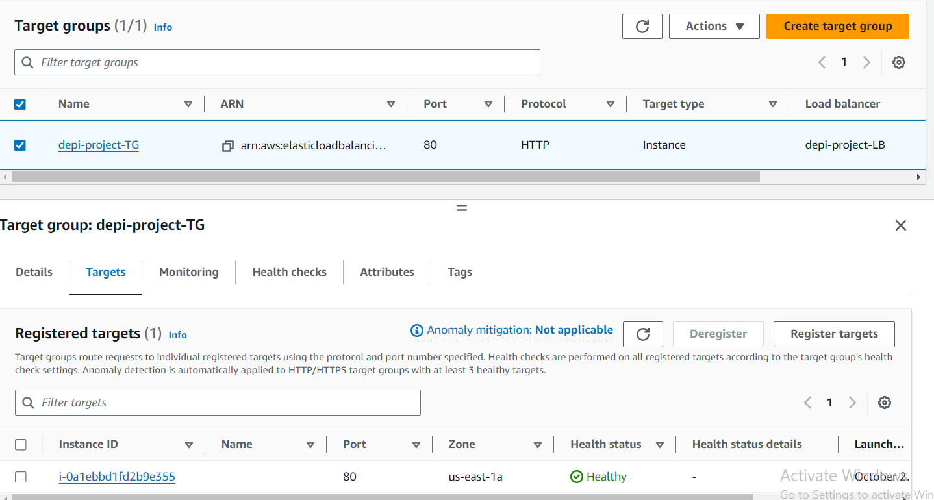
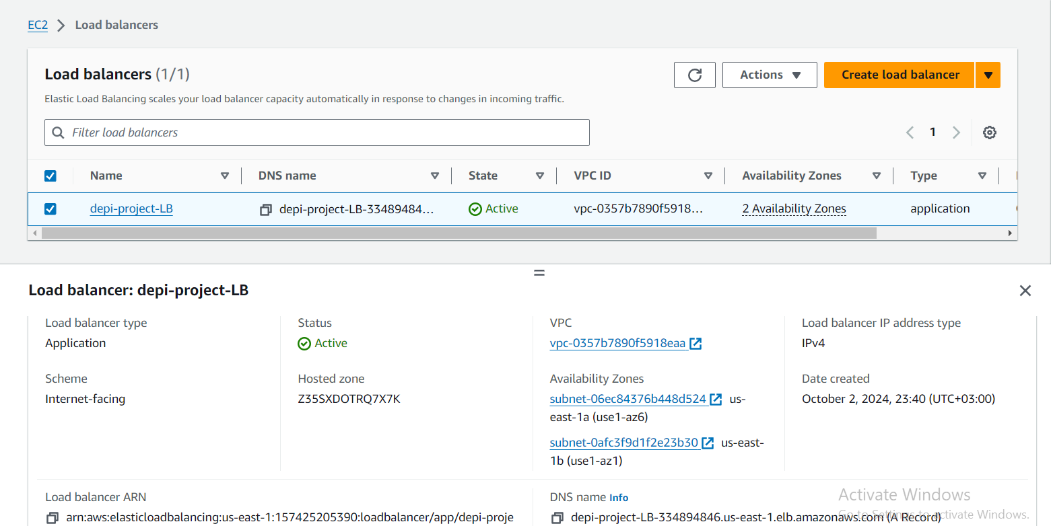
Project Steps
Step 4 : Configure Target Group and Load Balancer
a Target Group was created for the EC2 instances across two Availability Zones (AZs). This ensures that traffic is distributed evenly across multiple instances located in different AZs for high availability
n Application Load Balancer (ALB) was configured to route incoming traffic to the EC2 instances in the target group
The load balancer’s security group was configured to allow HTTP/HTTPS traffic while ensuring that only valid traffic reaches the instances

Slide 12
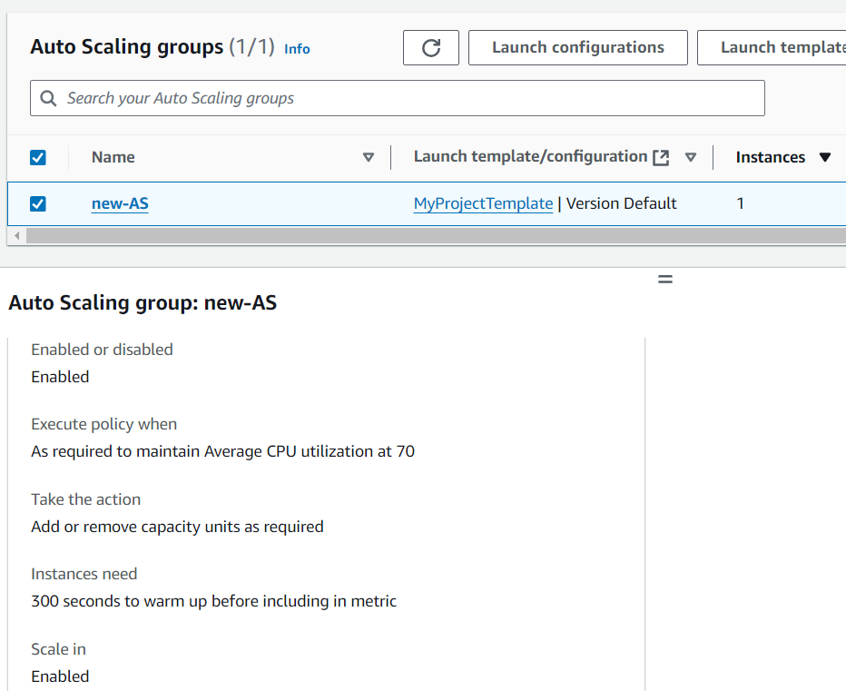
Project Steps
Step 5 : Configure Auto Scaling Group
An Auto Scaling Group (ASG) was created using the previously defined Launch Template with desired capacity 1 , Min. 1 and Max.2 instances . This ASG allows for the automatic scaling of EC2 instances based on cloudWatch alarm .
The ASG is attached to the Application Load Balancer (ALB) created earlier, allowing the load balancer to distribute traffic across the dynamically scaled instances.
CloudWatch was configured to monitor CPU utilization. If the average CPU utilization exceeds (70%), the ASG automatically scales up by launching new instance,and if CPU utilization is low, the ASG scale down automatically .

Slide 13
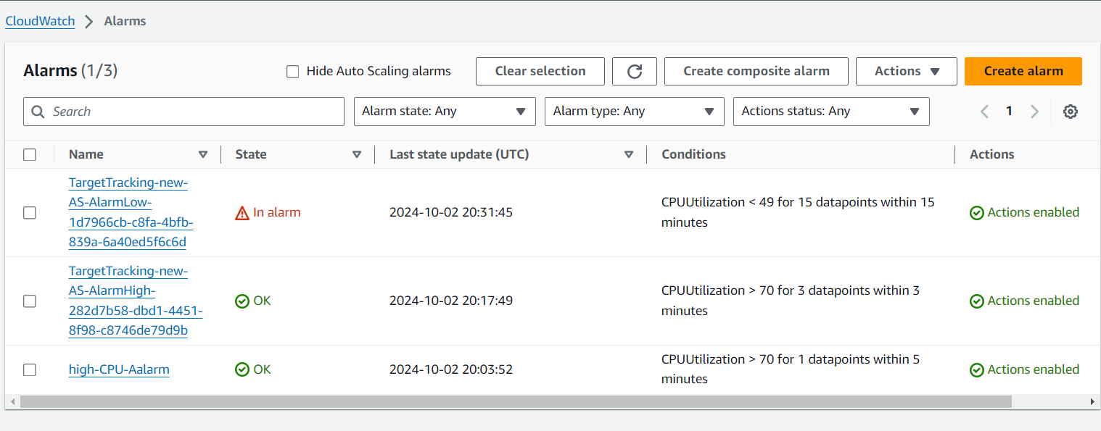
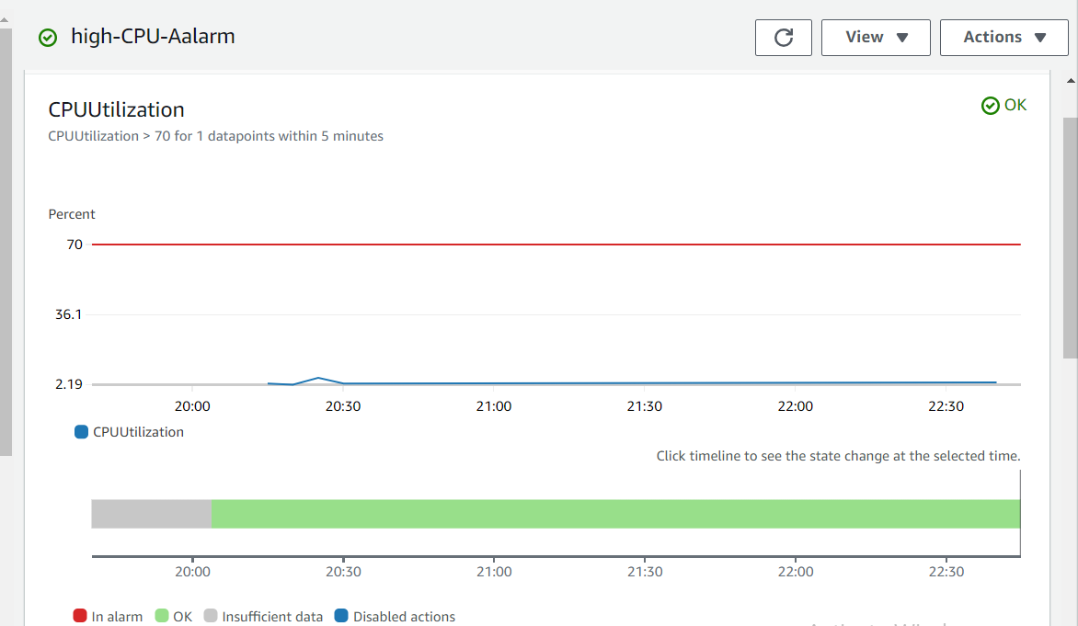
Project Steps
Step 6 : Configure Monitoring with CloudWatch Metrics and SNS Notifications
CloudWatch Metrics were set up to monitor the CPU utilization of the EC2 instances within the Auto Scaling Group (ASG).
An Amazon SNS (Simple Notification Service) topic was created to send notifications via my email and attached to the cloudWatch alarm.
The CloudWatch Alarm is configured to trigger notifications to the SNS topic if CPU utilization exceeds 70%

Slide 14
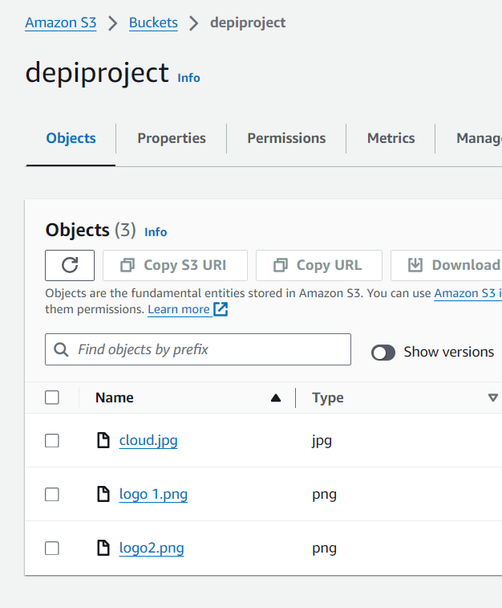
Project Steps
Step 7 : Integrate S3 Storage
An Amazon S3 (Simple Storage Service) bucket was created to Store my web application’s static content (images) so If any content is lost from the EC2 instances, i can easily recover it from the S3 bucket.

Slide 15

High availibilty and Scalability
1
Auto Scaling Group
Automatically adjusts the number of EC2 instances
based on traffic demand, ensuring scalability
.
2
Application Load Balancer
Distributes traffic across instances in different
availability zones, ensuring high availability.
3
Multiple Availability Zones
Ensures that the failure of one AZ won’t bring
down the application.

Slide 16



Security Considerations
Network Security Groups (NSGs)
Restrict access to EC2 instances to control inbound and outbound traffic..
VPC Isolation
he entire infrastructure is within a Virtual Private Cloud
for isolation from the public internet.

Slide 17
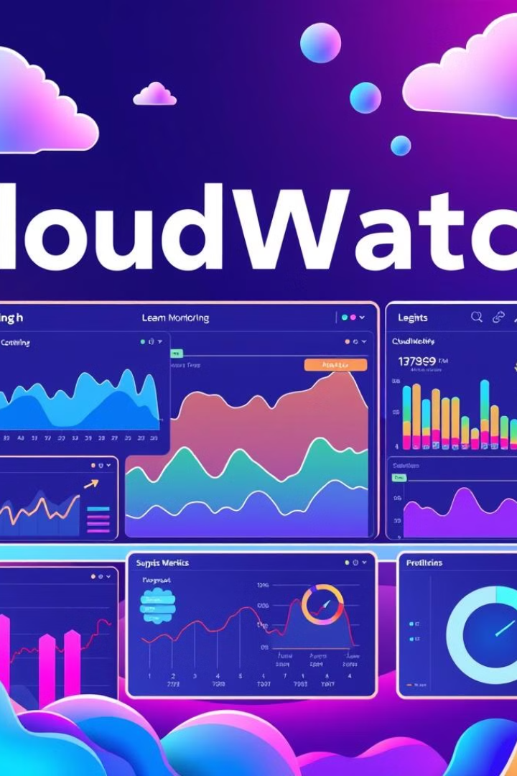
Monitoring with CloudWatch
CloudWatch Metrics
Monitors CPU Utilization.
SNS Email Notifications
Automatically notify administrators of critical issue.

Slide 18



Disaster Recovery Plan & Remediation
Multi-AZ Deployment
EC2 instances and resources deployed across AZs for
high fault tolerance.
Self-Healing Systems
EC2 auto-scaling helps maintain system health
by replacing unhealthy instances.

Slide 19
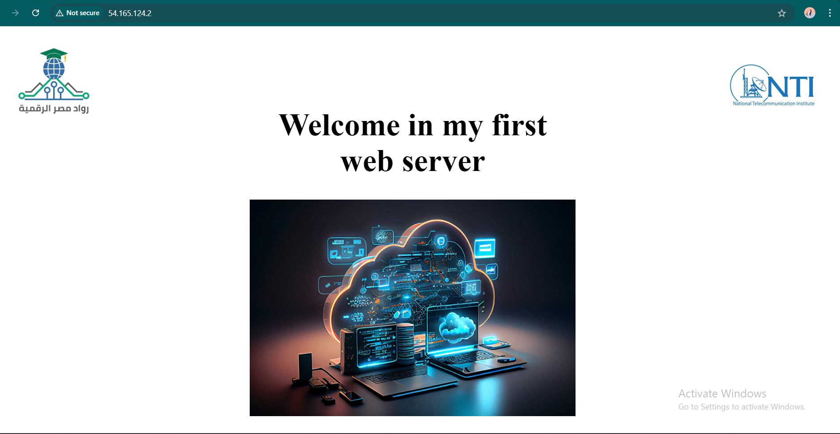
The Web page

Slide 20

Thank you
Digital Egypt Pioneers initiative
Provided by NTI
Final Project

